Slide 1
Presentation
PERFORMANCE BASED SEISMIC DESIGN
NAME(ID): NAMIT SHRIVASTAVA(2020A2PS1767P)
Supervisor : DIPENDU BHUNIA
Department of Civil Engineering

Slide 2

HISTORY
The theory of performance-based seismic design (PBSD) was first proposed in the early 1990s by American scientists and engineers. It piqued the interest of Japanese and European earthquake engineers, who dedicated themselves to it from all angles. The PBSD idea evolved from Moehle's displacement-based seismic design (DBSD) at Berkley University in California. It is based on structural analysis and represents a significant advancement in seismic theory.
Traditional elastic methods have been used to design structures subjected to seismic loadings. This method arose naturally from the application of elastic analysis methodologies to assess structural performance under working stresses. The ultimate strength provisions have been used to set acceptability standards for load combinations on structures, including seismic effects. Because ductile structures may withstand dynamic loads greater than the elastic limit load, seismic loads are frequently decreased in this process by dividing the loads by ductility factors.

Slide 3
Introduction
The primary idea behind performance-based seismic design is to give engineers the capacity to design buildings that will behave predictably and consistently in earthquakes.
As a result, performance-based seismic design is a method for designing new buildings or upgrading existing ones with a realistic awareness of the risk of life, occupancy, and economic damage that future earthquakes may bring.
The selection of design requirements expressed in the form of one or more performance objectives is the first step in performance-based design. At a given degree of seismic hazard, each performance objective is a statement of the acceptable risk of incurring precise amounts of damage and the resultant losses that occur as a result of this damage.

Slide 4
Distinguishing Characteristics
Performance Based Seismic Design allows the owner, architect, and structural engineer to choose both the appropriate level of ground shaking and the chosen level of protection for that ground motion.
Multiple levels of ground shaking can be evaluated, with a different level of performance specified for each level of ground shaking.
Target building performance levels range from Continued Operation, in which the building and nonstructural components are expected to sustain almost no damage in response to the design earthquake, to Collapse Prevention, in which the structure should remain standing, but is extensively damaged.
Specific ductility factors ("m" values) are specified for each component of the seismic force-resisting system. The ductility factor varies depending on the target building performance level, material type, and the relative ductility of the component.

Slide 5
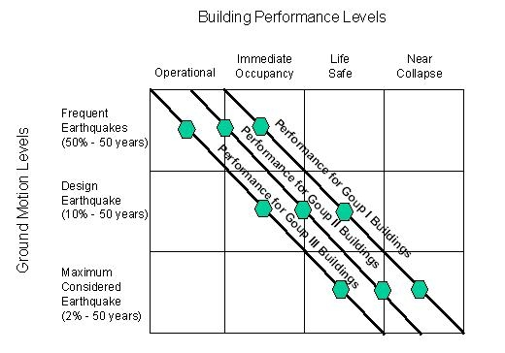
A graphical illustration of a performance objective matrix that compares earthquake hazard levels (y axis) to target building performance levels (x axis) (x axis).
The three diagonal lines show the performance goals for various construction groupings.
Group I is a typical commercial structure, but Groups II and III are structures that require a higher level of security, such as hospitals, fire stations, data centres, critical manufacturing facilities, and so on.

Slide 6
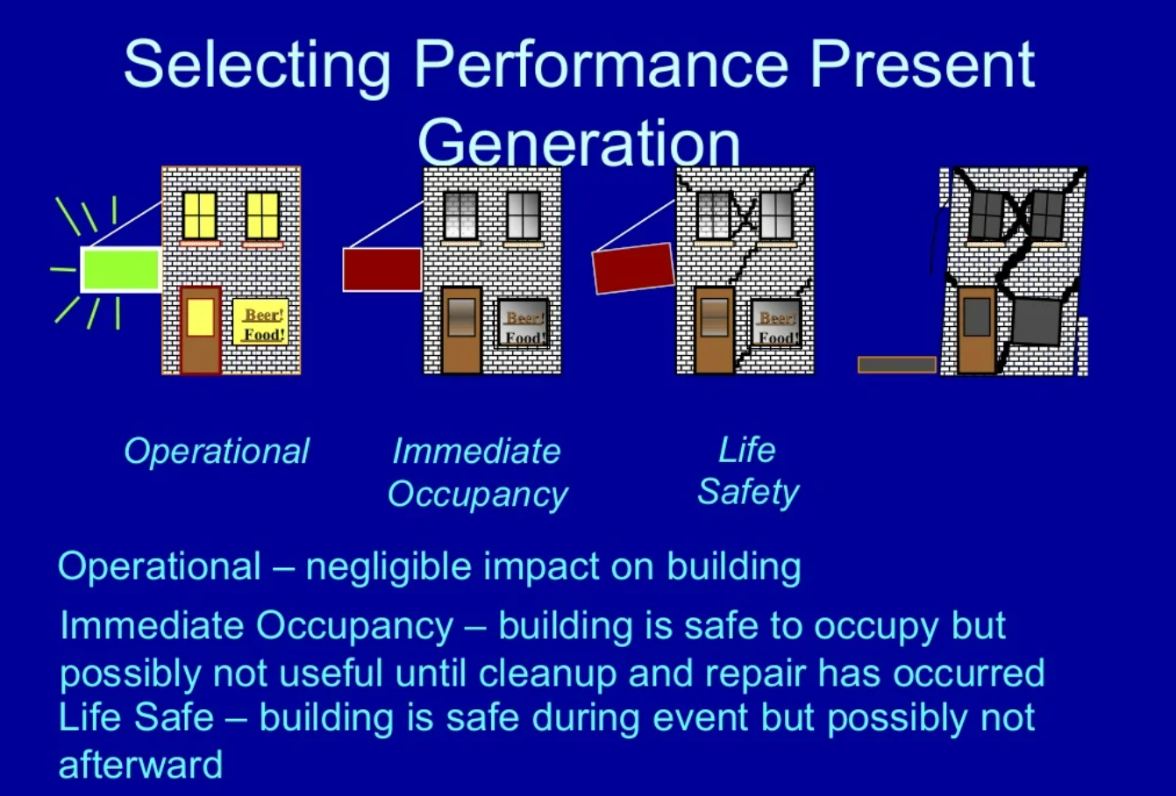
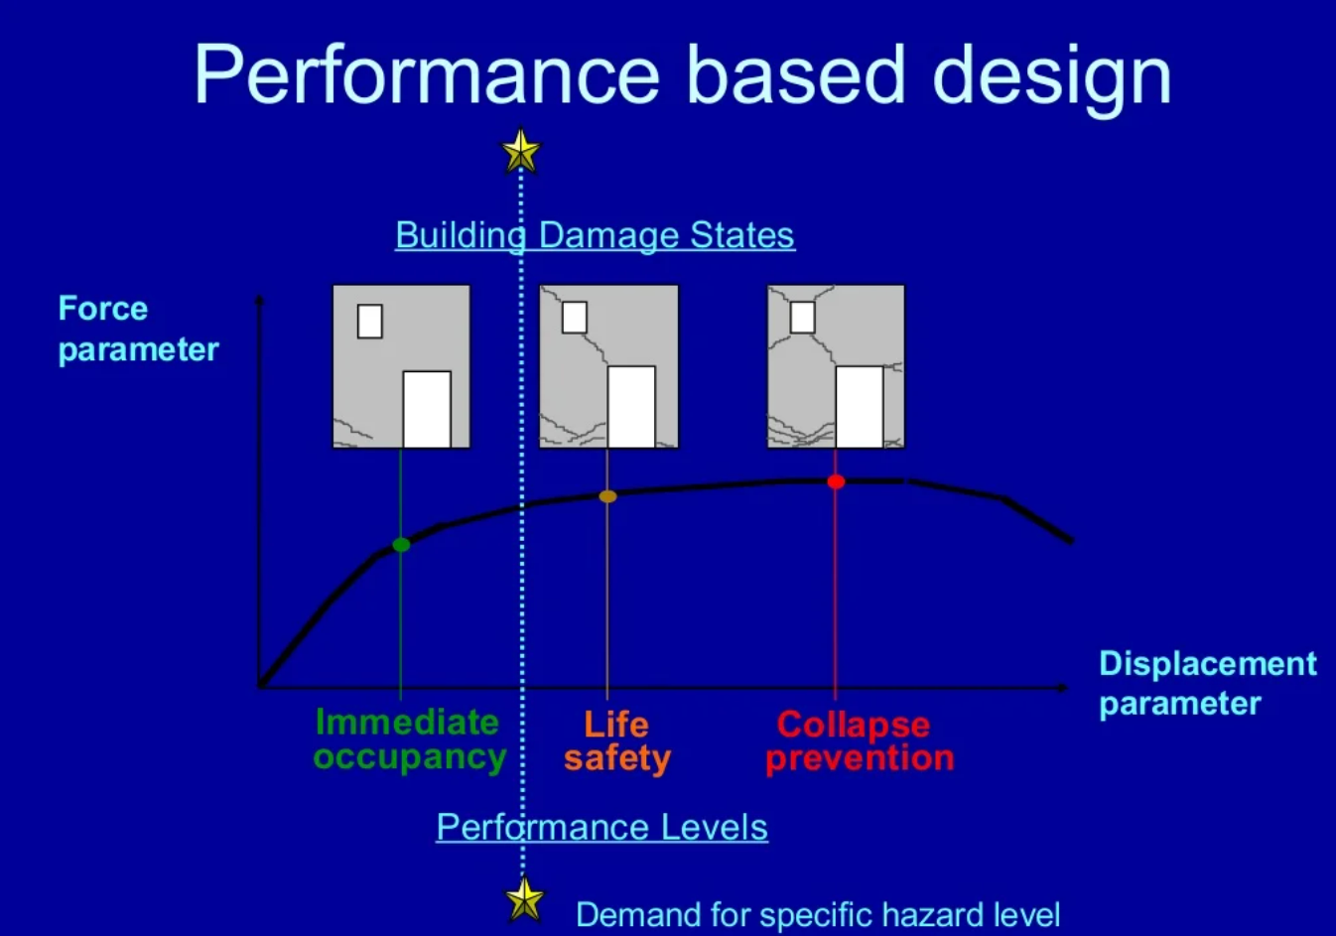

Slide 7
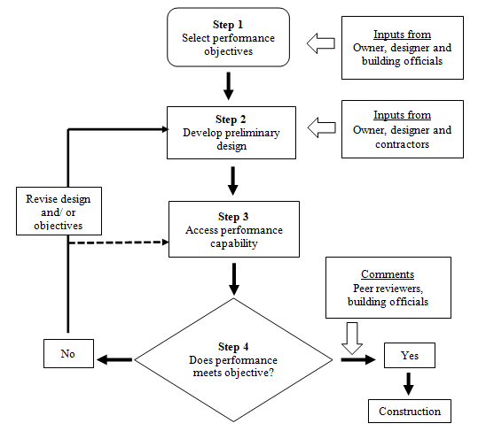
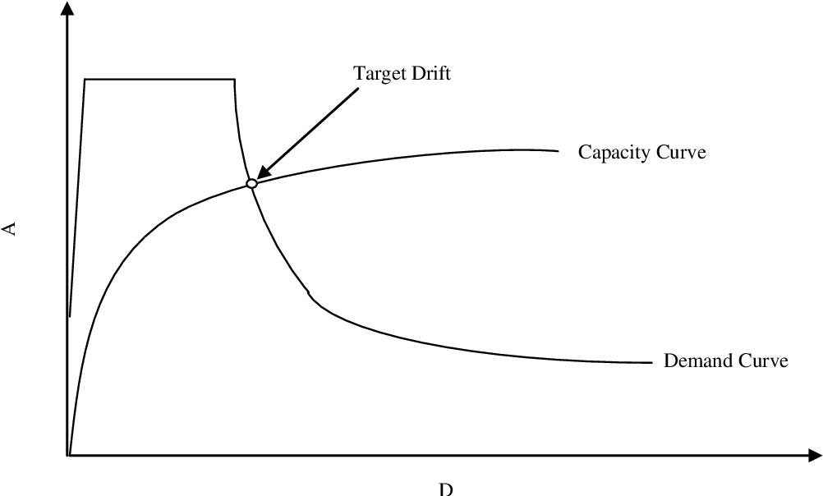
Design methods used by PBSD theory
A set of rational function levels is established, and quantitative metrics such as beam and column bending, shear, and axial deformation, as well as plastic performance of their connections, are given.
The target performances are decided by the structure's role and importance. The distinction between the PBSD seismic design approach and the typical structural design system is the emphasis on displacement properties and nonlinear inelastic static analysis of structures.

Slide 8
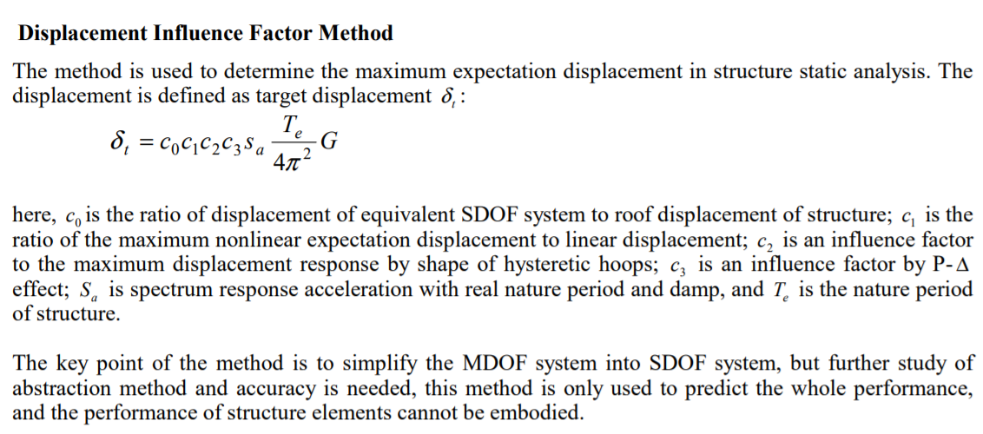

Slide 9
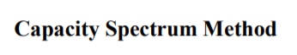
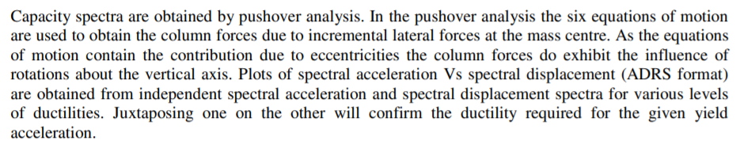
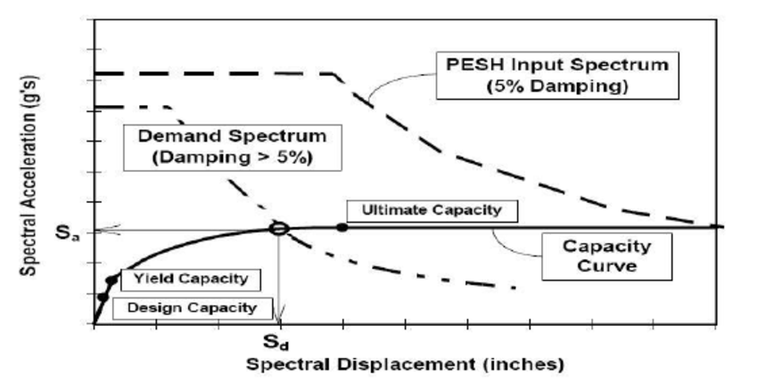

Slide 10
FORESEE RESEARCH AND APPLICATION
The theory of PBSD is not mature yet. Further researches are needed before it is used extensively.
To the earthquake risk, transition from intensity to zonation according to ground motion parameters is required. The meanings of minor, moderate and major earthquake should be defined clearly. In China, the new mapping is finished on the basis of earthquake action factor K =α g and characteristic period Tg .
To the structure performance, the obscure meanings of non-damage, repairable and no collapse and so on should be verified. The target performance levels should be defined quantitatively.
To the response spectrum used in design, long period component, near- field effect and duration of earthquake should attract attention, and velocity spectrum, displacement spectrum, energy spectrum and/or capacity spectrum may substitute the acceleration spectrum in design.
To the design method, the linearity method of transmitting from MDOF to equivalent SDOF system should be improved or completed to make PBSD applicable.
To the standard of damage and function destroyed, the probability norm may be more suitable, and the subentry factor method used to describe limit state may be modified.

Slide 11
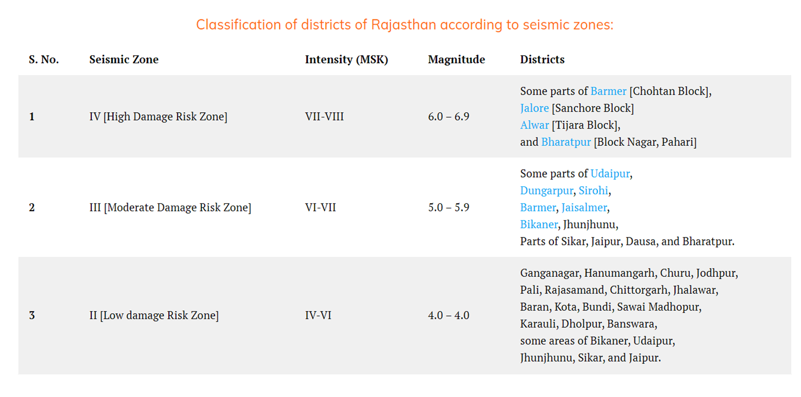

Slide 12
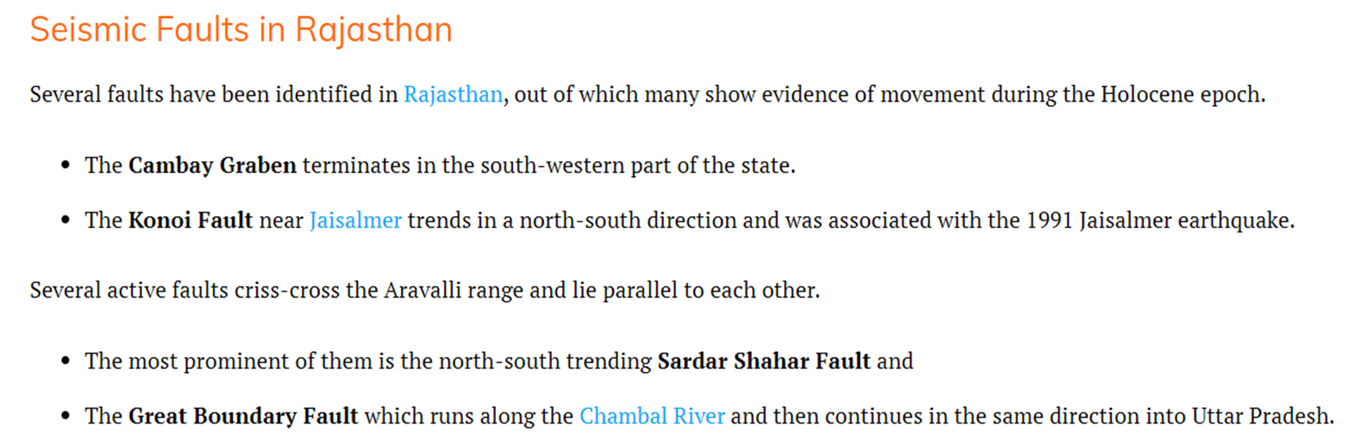

Slide 13
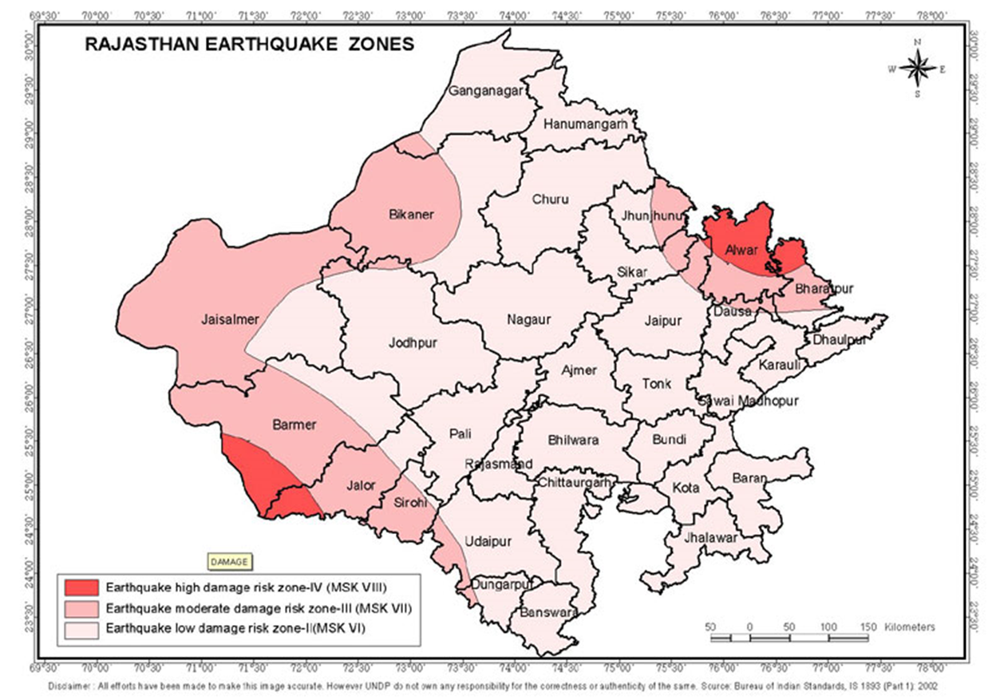

Medvedev–Sponheuer–Karnik scale, also known as the MSK or MSK-64, is a macroseismic intensity scale used to evaluate the severity of ground shaking on the basis of observed effects in an area where an earthquake transpires

Slide 14
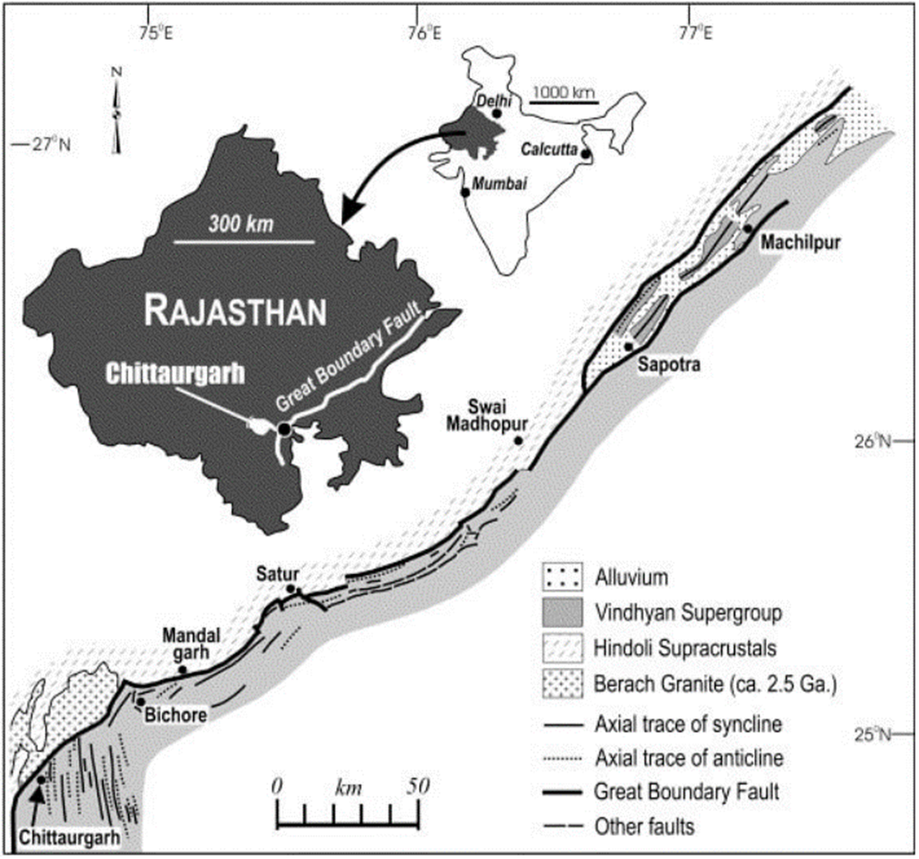
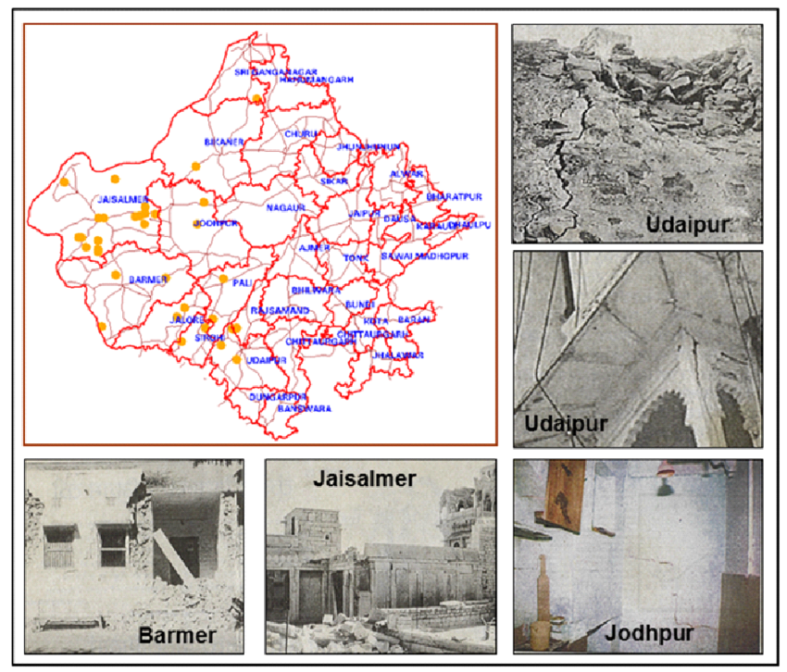

Slide 15
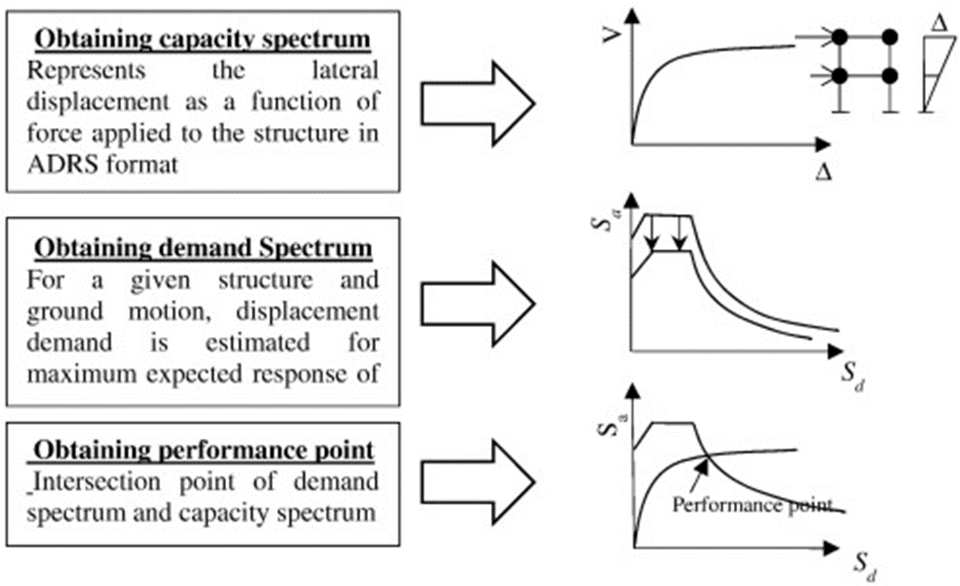
Acceleration Displacement Response Spectrum format .
Required Capacity of Nonlinear Deformations of the SDOF System with the Pushover Analysis
Pushover analysis is a static process that estimates seismic structural deformations using a reduced nonlinear technique. During earthquakes, structures remodel themselves. The dynamic forces on a structure are moved to other components as individual components yield or fail.

Slide 16
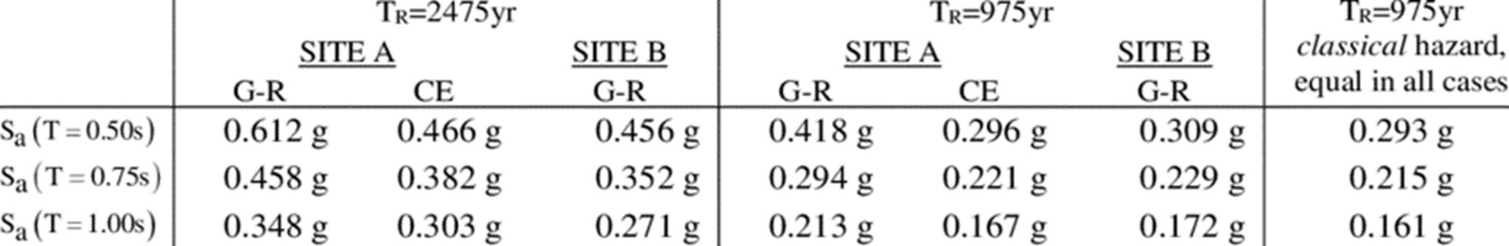
The design eccentricity is a function of the structural eccentricity, which is defined as the distance between the center of rigidity at a level and the resultant of all lateral forces at that level.
RELEVANT BUILDING SURVEYOR
A registered building surveyor who has been selected to provide independent oversight of buildings and building work throughout the construction process and upon completion of construction to ensure that buildings are safe for use, accessible and energy efficient.

Slide 17
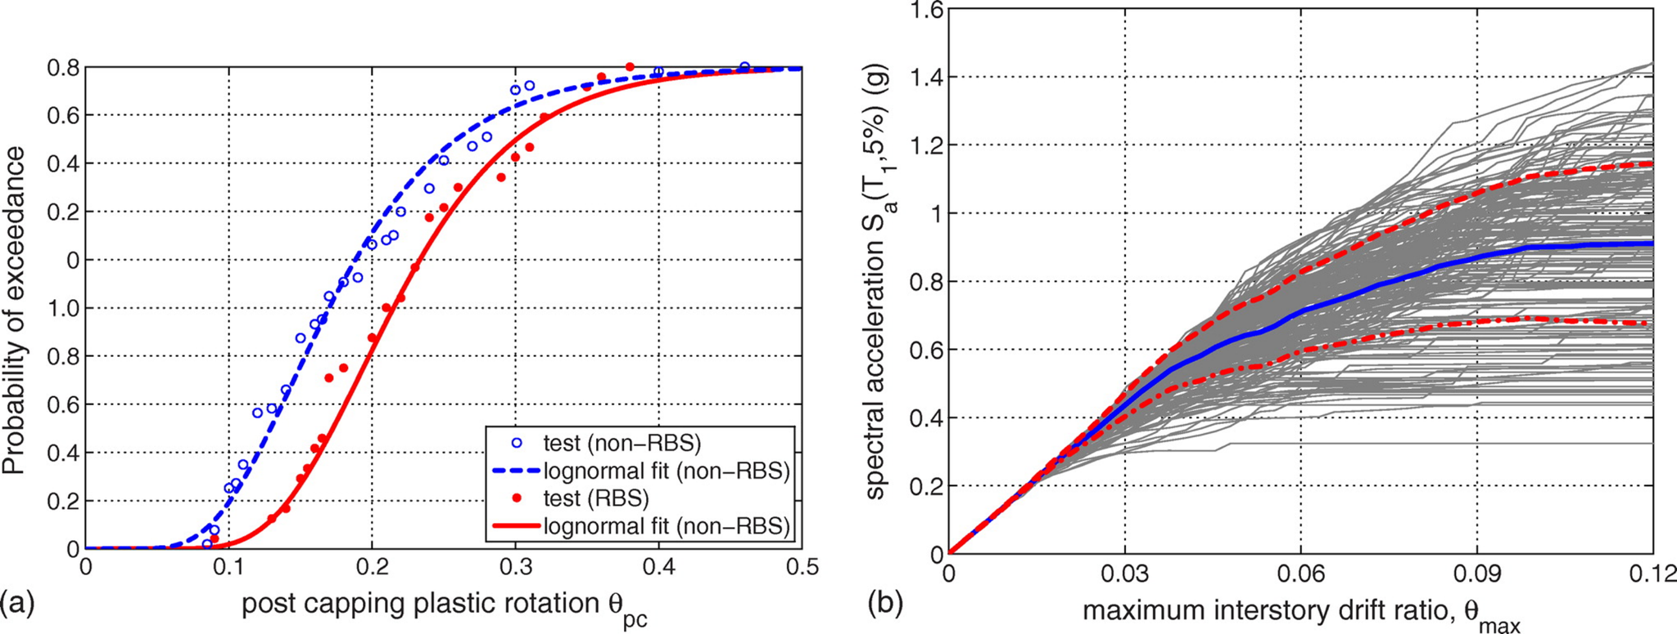
Spectral acceleration (SA) is a unit measured in g (the acceleration due to Earth's gravity, equivalent to g-force) that describes the maximum acceleration in an earthquake on an object – specifically a damped, harmonic oscillator moving in one physical dimension.

Slide 18
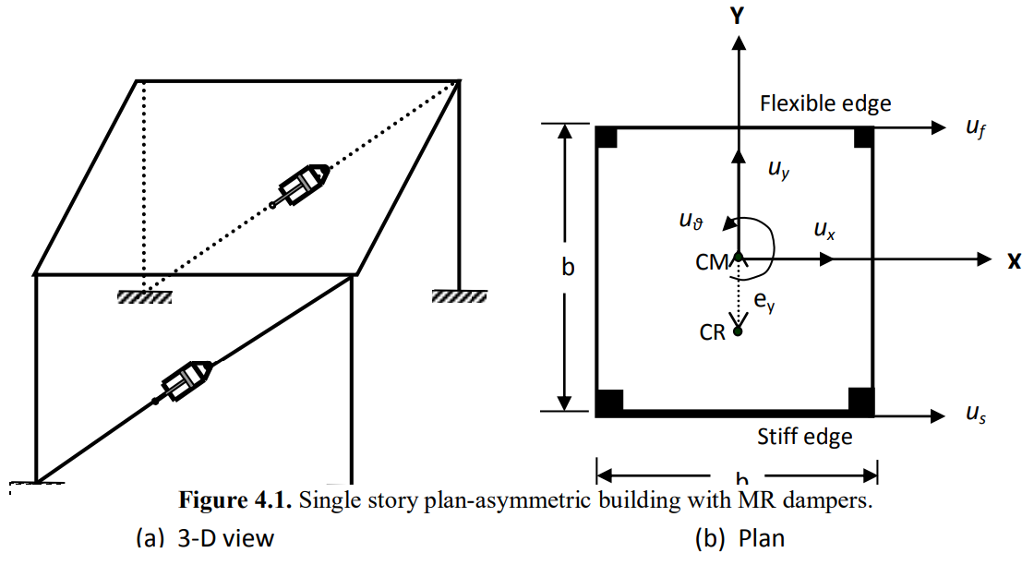
STRUCTURAL MODELLING
A magnetorheological damper, also known as a magnetorheological shock absorber, is a damper filled with magnetorheological fluid that is controlled by a magnetic field, which is often generated by an electromagnet.
This permits the shock absorber's damping characteristics to be continually changed by altering the electromagnet's power. As the magnetic intensity rises, so does the fluid viscosity within the damper.

Slide 19
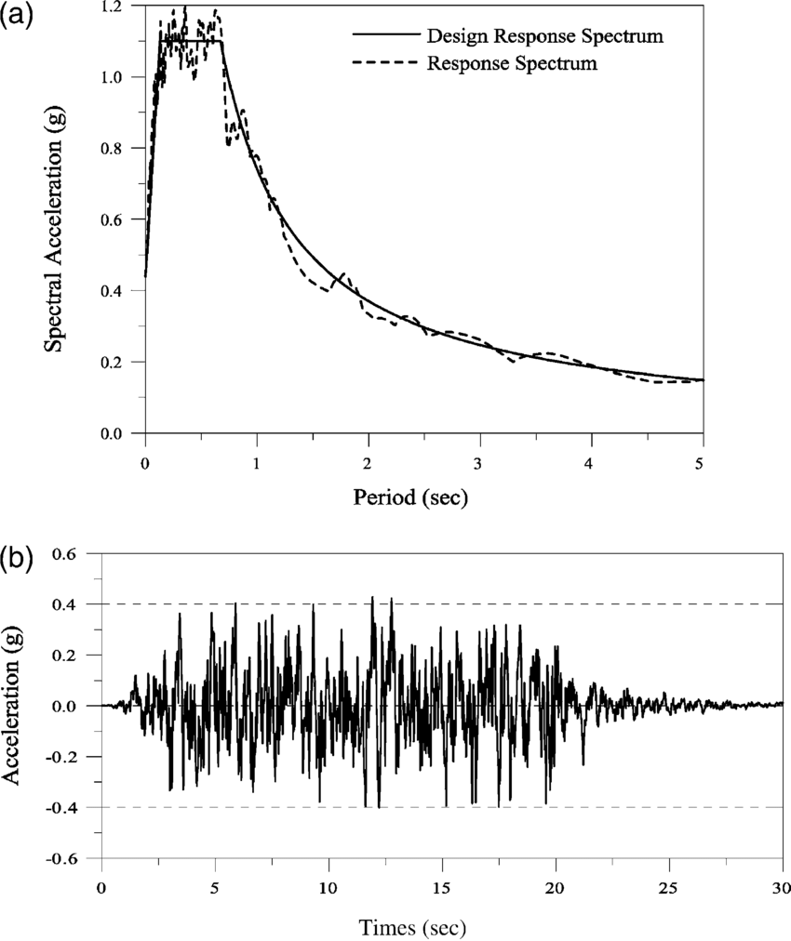
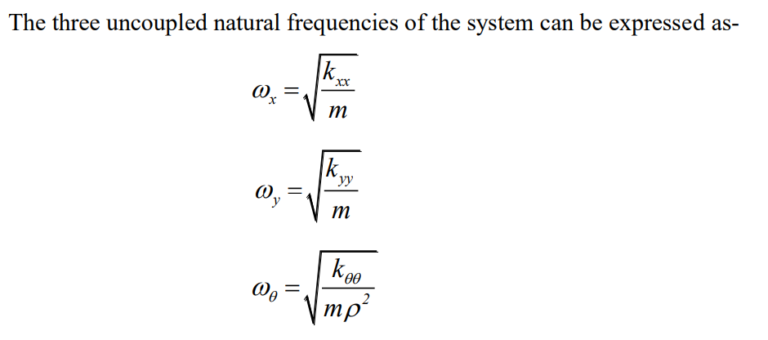
In addition, the system includes MR dampers installed in the bracing systems in the X-direction. The building model considered is an idealised one-story one-way plan asymmetric building consisting of rigid deck supported by structural elements (i.e. wall, columns, moment-frames, braced frames, etc.) in each of the two orthogonal directions.
The mass attributes of the system are regarded symmetric about both axes, whereas stiffness properties are only symmetric about the Y-axes. The stiffness eccentricity, ey, is defined as the distance between CM and CR and describes the absence of symmetry in the stiffness qualities about X-axes (Figure 4.1).

Slide 20

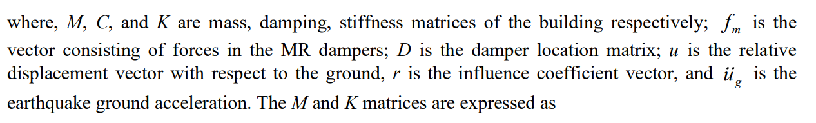
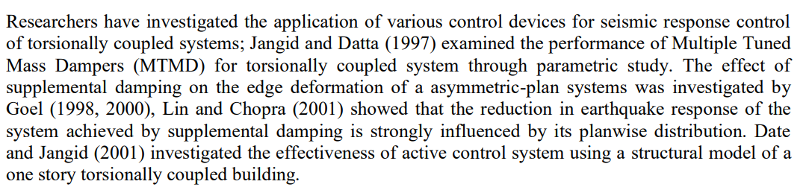
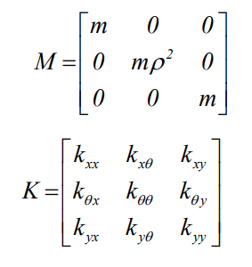

Slide 21
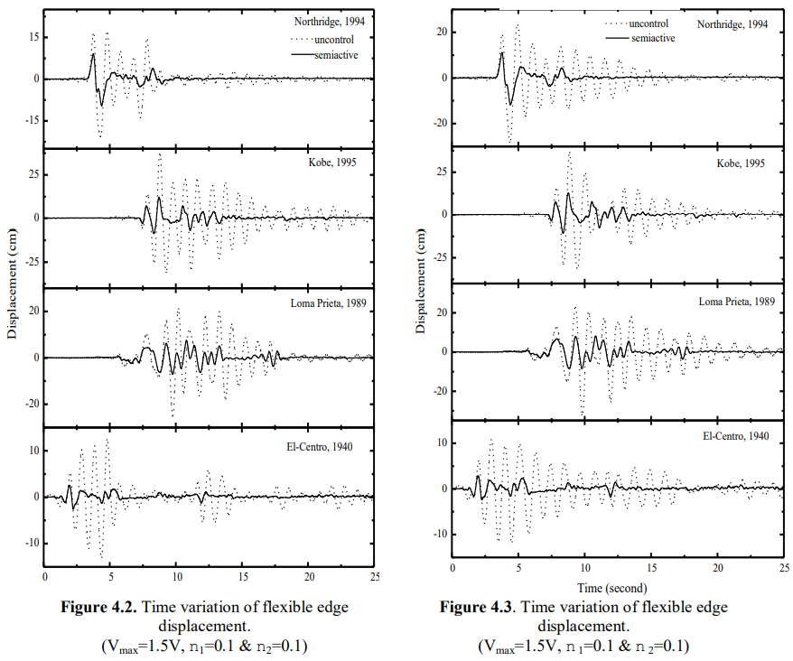

Slide 22
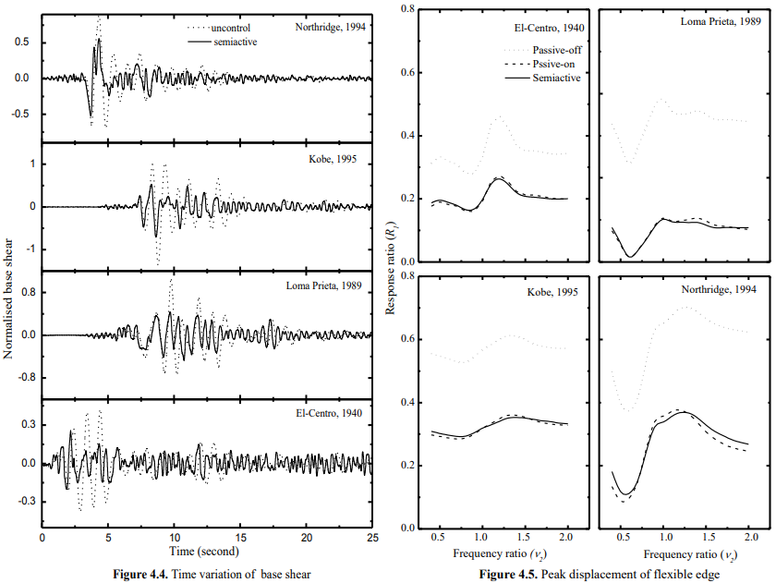

Slide 23
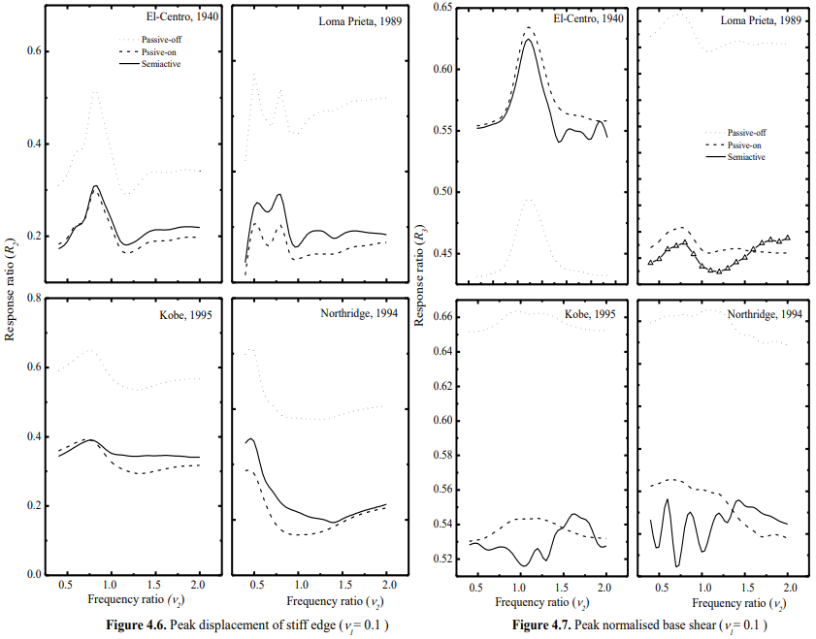
Passive off here means negative stiffness (superior performance)
Passive on here means positive stiffness (poor performance)

Slide 24
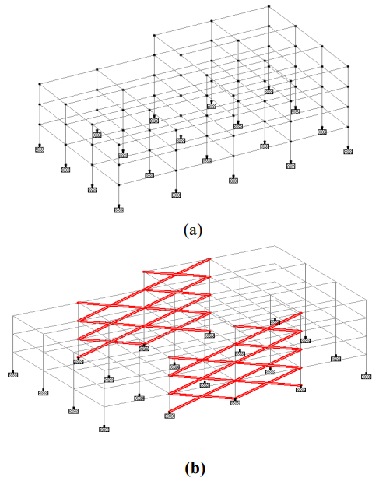
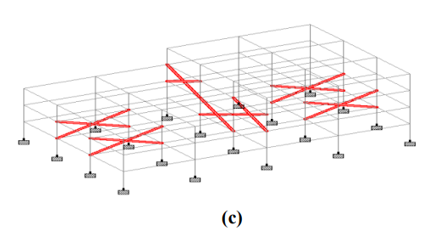
PBSD procedure in STAAD Pro Advanced Following Nonlinear Static Analysis
The study considers three structural steel frames of G+3 storey I moment frame, (ii) braced frame with external concentric diagonal bracing (bracing section –ISMC100), and (iii) braced frame with internal diagonal bracing (bracing section –ISMC100) at optimal position, as shown in fig 2 (a), (b), and (c), respectively.
Fig 2.
Structural Modeling of Steel Frames in STAAD Pro. Advanced, (a) moment frame;
(b) braced frame with external concentric diagonal bracing;
(c) braced frame with internal diagonal bracing

Slide 25
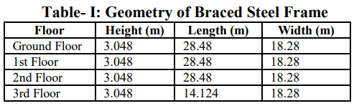
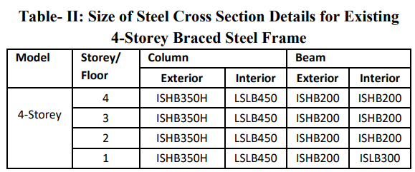
The geometry of all three structural steel frames is shown in Table 1.
The cross sectional details of the beams and columns employed in all three frames are shown in Table 2. The strong column weak beam idea is considered while assigning steel sections to column and beam.
The modulus of elasticity of the steel used to produce the 4-Storey braced frame is 199947.9611 N/mm2, the Poisson's ratio is 300E-3, the density is 283E6 kip/in3, and the ὰ/oF is 6.5E6.

Slide 26
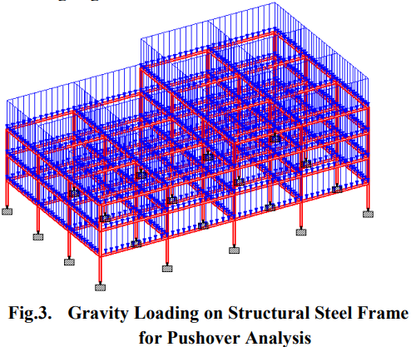
As illustrated in fig 3, each frame has its own self weight and life load of 3kN/m.
To do the pushover analysis in STAAD Pro. advanced, self weight and live weights were applied under gravity load conditions.
Figure 3 depicts the self-weight of the structure in red, and blue coloured arrows pointing downward illustrate the gravity load of 3Kn/m operating in the global Y direction.

Slide 27
PERFORMING PUSHOVER ANALYSIS
STAAD Pro. advanced is used to do pushover analysis on each structural steel frame of the G+3 story. While performing non-linear static analysis, the following steps were taken.
While performing pushover analysis in STAAD Pro, define the type of frame. Advanced frame types should be defined initially. Moment frame is the frame type for the first frame, and braced frame is the frame type for the second and third frames.
Geometric Non-linearity: In regular buildings, some structural damage is allowed during intense earthquake shaking, even though no collapse must be guaranteed. This indicates that nonlinearity will emerge in the building's overall response. As a result, the geometric non linearity is taken into account when assessing all three steel frames. The geometric nonlinearity convergence is set to 0.254mm, and the number of iterations for geometric nonlinearity is set at 50.
Defining Loads: In the gravity loading example, loads are defined. Gravity loads are made up of dead loads and (in most cases) most live loads. Each steel frame is given a live load of 3kN/m, as indicated in fig 3.

Slide 28
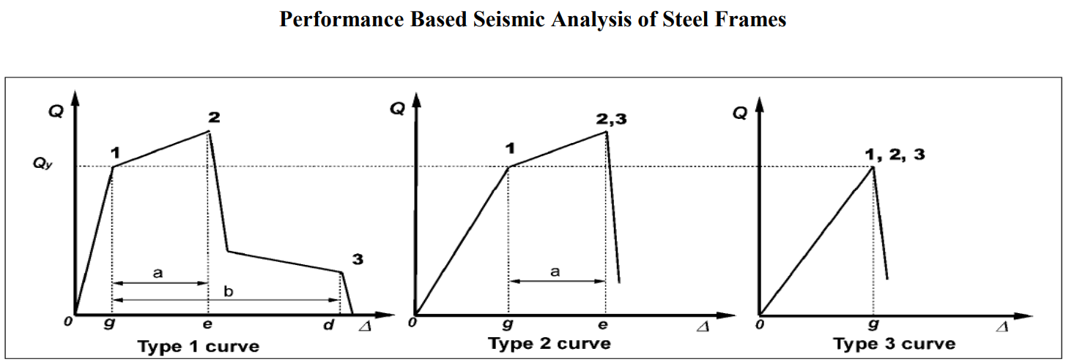
Defining acceptance criteria: Performance characteristics that regard all elements to be primary. As a result, the performance points are as illustrated in Figure 4's curves. IO is the distortion that caused persistent, visible damage in the experiment but did not exceed 0.67 times the LS deformation limit. The distortion at point 2 on the curves is 0.75 LS. CP is the curve deformation at point 2 that is less than 0.75 times the curve deformation at point 3.
Component force v/s deformation curves from FEMA 356
Fig 4.

Slide 29
Defining Solution Control: A defined base shear or a defined displacement at a controlled joint can be used to do the analysis. As previously described in step 4 of doing pushover analysis, the push up to defined base shear technique is employed here.
Performance Check: The performance of all three G+3 structural steel frames was determined by pushover analysis, with comparisons of base shear, displacement, capacity curve, and plastic hinges computed to determine which structure satisfies the requisite performance under earthquake stress.

Slide 30
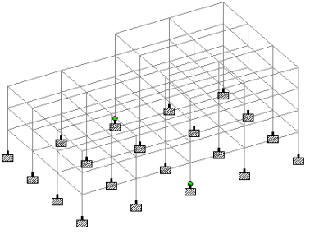
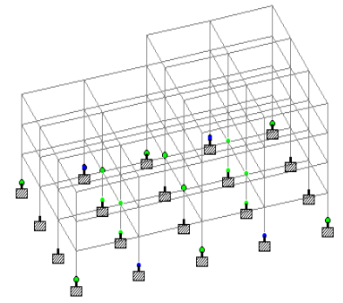
RESULT
Performance of Moment Frame: After completing pushover analysis on the G+3 storey steel frame, it performed linearly up to a base shear of 135.09KN, then nonlinearly as the base shear increased. As indicated in figure 5, the first plastic hinge is formed in column 9 and column 12.
At that point, the performance level is IO. When the base shear is increased to 3758.82 KN, blue coloured plastic hinges develop at columns 5, 8, 13, and 16, as illustrated in fig 6, indicating that the structure is between the IO and LS performance levels.
Fig 6.
Fig 5.
Members of Moment Steel Frame in IO Performance Level
Members of Moment Steel Frame in IO-LS Performance Level

Slide 31
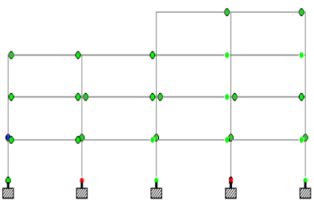
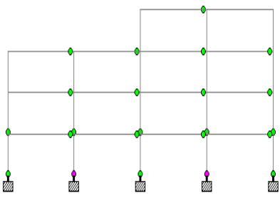
As the base shear reached 4218KN, pink coloured plastic hinges began to appear in column 5, 8, 13, and 16, as seen in fig 7, indicating that those structural components are performing at the LS-CP level.
As illustrated in fig 8, red coloured plastic hinges started forming into column 5, 8, 13, and 16 at the base shear 4392.60 KN, indicating that those structural components are in the CP level.
Members of Moment Steel Frame in LS-CP
Members of Moment Steel Frame in CP
Fig 7.
Fig 8.

Slide 32
Immediate occupancy (IO), life safety (LS) and collapse prevention (CP)
Base shear began redistributing to assess the performance of other structural parts when the member of the structure reached the CP performance threshold. No members had collapsed till that point. Columns 5 and 8 of the first member failed at the base shear 4260.87KN, as indicated by the red colouring.
However, the complete structure was not affected because the maximum columns are within the IO performance level, as illustrated in fig. The highest number of beams and columns are in the CP and LS levels after distributing and redistributing base shear up to the push load step 173, but some of them are collapsed as shown in fig when the redistributed base shear was 2380.60 KN.
After that, the entire structure will fall because the base storey's maximum number of columns has failed, as seen in fig 9.
The capacity curve for a moment frame is given in fig 10, where the X-axis represents the displacement at the roof caused by base shear, which is displayed on the Y-axis.

Slide 33
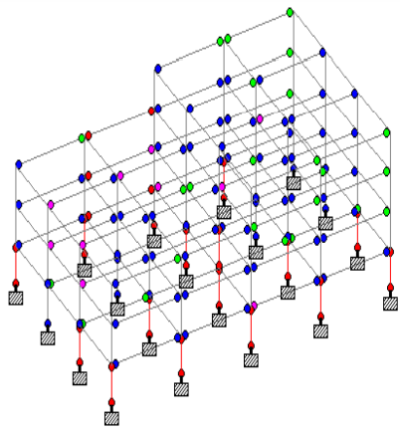
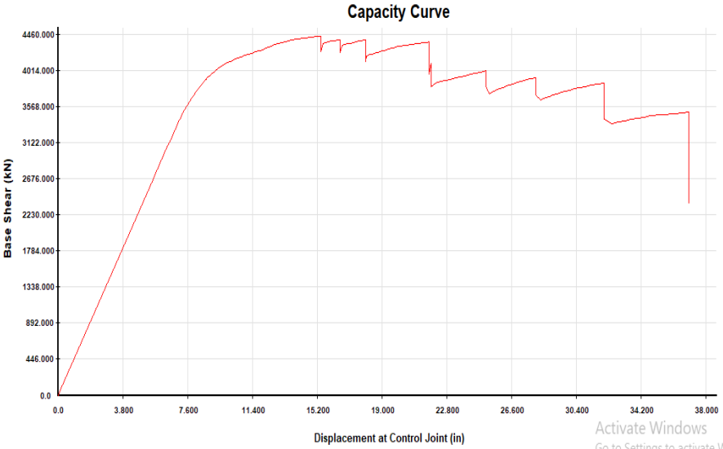
Capacity Curve of Moment Frame
Fig 10.
Members of Moment Steel Frame Failed in Pushover Analysis
Fig 9.

Slide 34
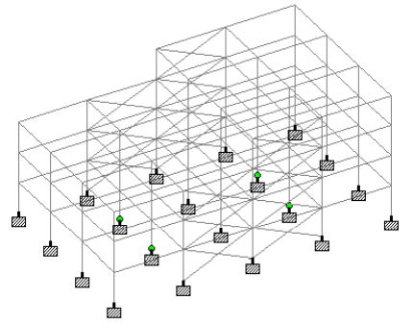
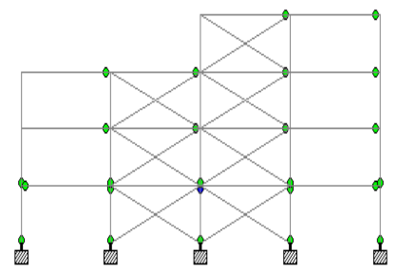
Performance of Externally Braced Frame: The static nonlinear process was used to assess the G+3 storey frame, which functioned linearly up to the base shear of 137.70KN. As illustrated in fig11, when the base shear is 3879.86KN, column 6,7,14, and 15 are in the IO performance level, with green coloured plastic hinges.
When the base shear reached 5161.37KN, column 10 and 11 were in the IO – LS performance level, as shown in fig 12. When the base shear reached 5406.2794KN, column 10 and 11 were in the LS-CP performance level, as shown in fig 12.
Fig 12.
Members of Externally Braced Steel Frame in IO-LS
Members of Externally Braced Steel Frame in IO
Fig 11.

Slide 35
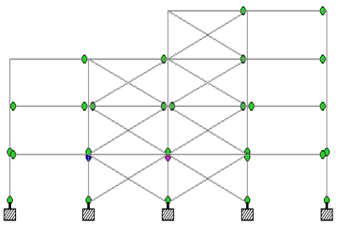
Figure 13 shows the complete CP level when the base shear is 5545.04KN.
As illustrated in fig 14, the bracing supplied began to fail when the base shear was 5636.119KN. External bracings boost the structure's lateral load carrying capacity, but displacement increases as well, resulting in structural failure.
The base shear was then redistributed up to the push load stem 231 and the basement's maximum columns failed at base shear 6039.11KN.
Fig 13.
The entire structure will then collapse. Figure 15 depicts the capacity curve for this period.
Members of Externally Braced Steel Frame in LS-CP

Slide 36
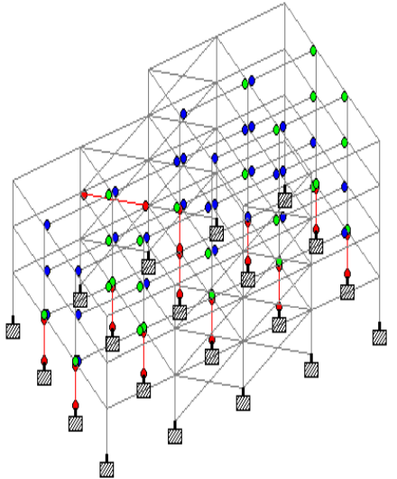
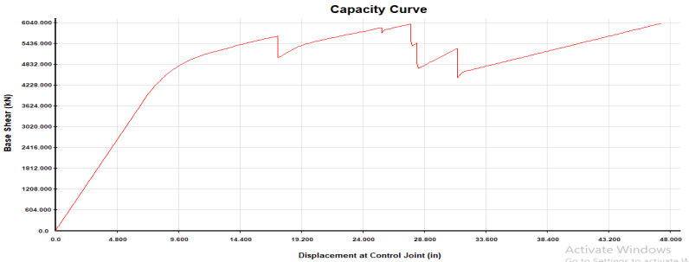
Fig 15.
Fig 14.
Members of Externally Braced Steel Frame Failed in Pushover Analysis
Capacity Curve for Externally Braced Steel Frame

Slide 37
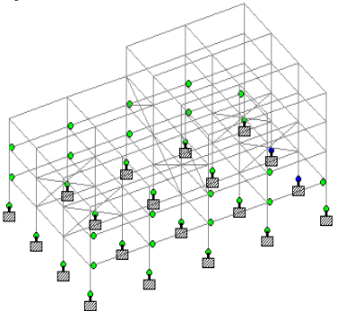
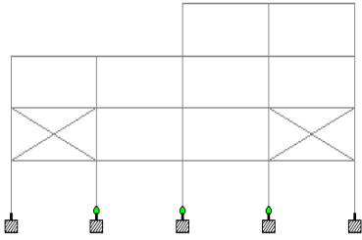
Performance of Internally Braced Frame at Optimal Position:Following the findings of the previous two frames, the third frame was developed with internal bracings in place to prevent the failure of members seen in the first and second frames. For that goal, various bracing positions were tested, and the frame depicted in this study with the ideal bracing position yielded the most accurate collapse prevention findings.
As demonstrated in fig 16, column 5,8,912,13, and 16 in a G+3 internally braced steel frame are in IO performance level ate base shear 3536KN. When the base shear is 4517.66 KN, column 27 and 31 attain the IO-LS performance level, as illustrated in fig 17.
Fig 17.
Fig 16.
Members of Externally Braced Steel Frame in IO-LS
Members of Internally Braced Steel Frame in IO

Slide 38
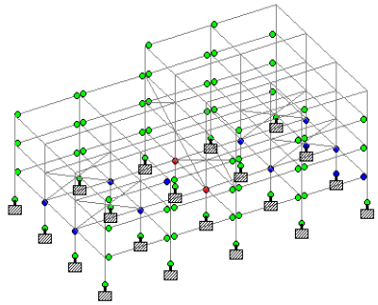
When the base shear is 5128.46KN, column 10 and 11 in fig 18 are I LS-CP levels. At base shear 5222.86KN, the same columns were the first in the entire structure to exceed CP level. In this design, the structure's base shear bearing capacity is improved, while its displacement is reduced as compared to an externally braced frame. As a result, the construction is safe.
After completing all of the push load steps, it was discovered that no members had failed. Only columns 10 and 11 were in the CP level, but the rest of the structure was secure. Figure 19 depicts the capacity curve.
Fig 18.
Members of Externally Braced Steel Frame in LS-CP Performance Level

Slide 39
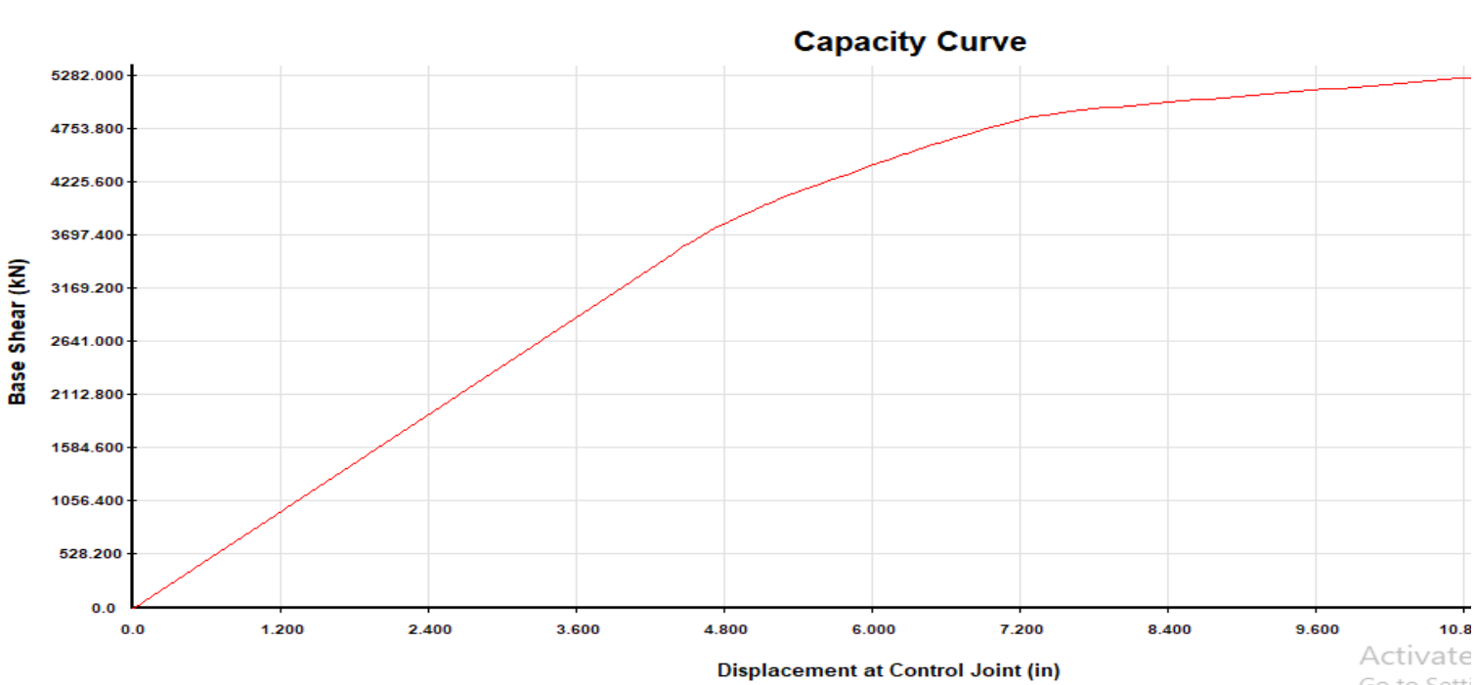
Capacity Curve for Externally Braced Steel Frame
Fig 19.

Slide 40
CONCLUSION
Nonlinear static analysis was used to successfully execute the notion of performance-based earthquake design by applying incremental lateral stresses to braced and non-braced steel frames. Using STAAD Pro. Advanced, the performance criteria provided by FEMA 356 can be successfully incorporated in the PBSD pushover analysis approach.
Under incremental push loads, the maximum members of the moment frame reach the Collapse prevention level and eventually fail. This causes the entire steel frame to collapse during the earthquake. External steel bracings can be added to the structural system to boost the structure's shear capacity. However, bracing fails under progressive lateral loads.
This causes structural members to fail during an earthquake since the maximum members are in the CP level. To avoid this, pushover analysis can be used to identify which members are failing following incremental lateral load and the position of bracing that prevents these members from failing.
During an earthquake, this perfect bracing location saves the structure. It is determined that a properly braced steel frame boosts the structure's shear capacity and performs effectively, especially at the LS level. After incremental lateral loads, no member collapse is seen in this frame. Pushover analysis has been effectively used to investigate nonlinear structural behaviour under earthquake loading.

Slide 41
REFERENCES
https://www.iitk.ac.in/nicee/wcee/article/13_1823.pdf
https://link.springer.com/article/10.1007/s40091-015-0080-y
http://ignited.in/I/a/304875
https://www.iitk.ac.in/nicee/wcee/article/WCEE2012_1281.pdf
http://www.i-asem.org/publication_conf/asem17/1.SM/XH3A.5.SM1130_4175F1.pdf
https://www.constrofacilitator.com/seismic-design-of-steel-moment-frames/
https://www.mka.com/services/performance-based-seismic-design
https://store.ctbuh.org/technical-guides/137-performance-based-seismic-design-for-tall-buildings.html
https://onlinelibrary.wiley.com/doi/abs/10.1002/tal.637
https://journals.sagepub.com/doi/abs/10.1193/1.1586128
https://journals.sagepub.com/doi/abs/10.1193/1.4000046
https://iopscience.iop.org/article/10.1088/1757-899X/910/1/012008/pdf
http://www.sginstitute.in/activities/Civil/Day_6_1.pdf
https://www.iaset.us/IEEE-Civil

Slide 42
Thank You

